Slide 1
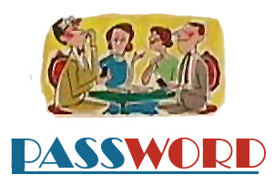
Ready to play?

Slide 2

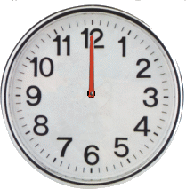
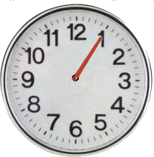
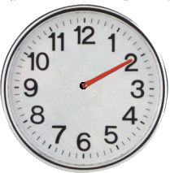
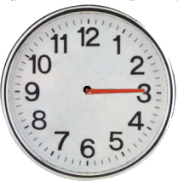
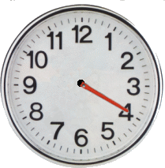
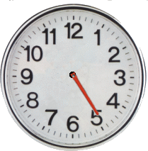
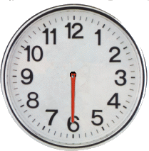
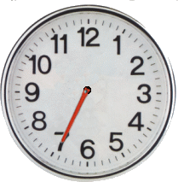
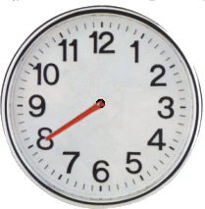
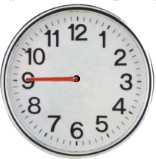
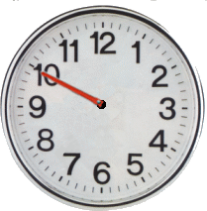
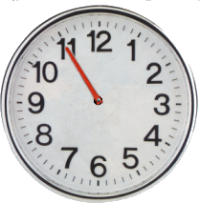
The
is…
I sleep when I am tired

Slide 3
The
is…
I write when I am stressed

Slide 4
The
is…
I eat a lot when I am nervous

Slide 5
The
is…
I am happy when I eat ice cream

Slide 6
The
is…
I sweat when I exercise

Slide 7
The
is…
I get some rest when I have a headache

Slide 8
The
is…
I have chicken soup when I have a stomachache

Slide 9
The
is…
I eat when I am hungry

Slide 10
The
is…
I listen to music when I am stressed

Slide 11
The
is…
I have nightmares when I eat a lot at night

